Slide 1
Impact of Disaster Events on Investment Returns via Contagion

Slide 2





Group Members
Niyati Srivastava
Nakul Haridas
Rohit Jain
Eby George
Parth Mahajan

Slide 3
Project Objective
Analysing Impact of major US disasters
Identifying channels of Contagion
Quantify the degree of impact via systemic risk
Using results to find ideal areas of investments

Slide 4
Disaster Events
Natural Disasters
Economic and other Disasters
2016 Floods
($71B)
California Wildfires
($148B)
Hurricane Katrina
($125B)
Covid-19
(>$15T )
1973 Oil Crisis
($105B)

Slide 5
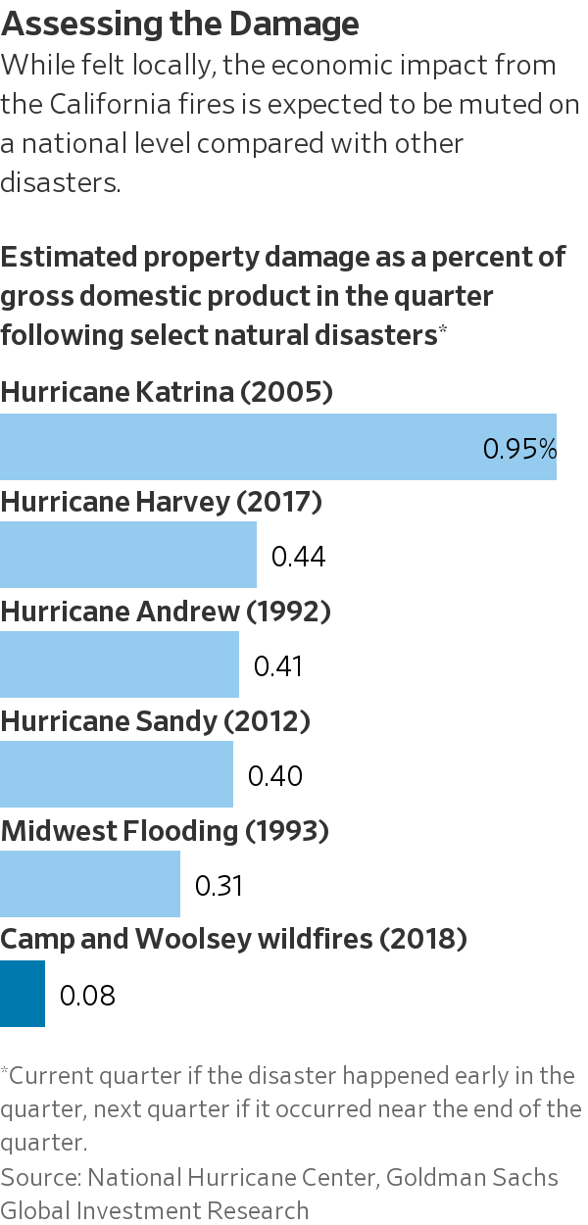
Impact of Disaster Events
Capital Market Impact
Stock Index Disruptions
Functioning of Industries
Spillover Contagion among sectors
Supply Chain Disruptions
Workforce disruptions
Human Capital
Loss of Lives
Inequities among population
Property Damage of Disasters as a % of GDP
*Snippets from Wall Street Journal and National Centers for Environmental Information

Slide 6
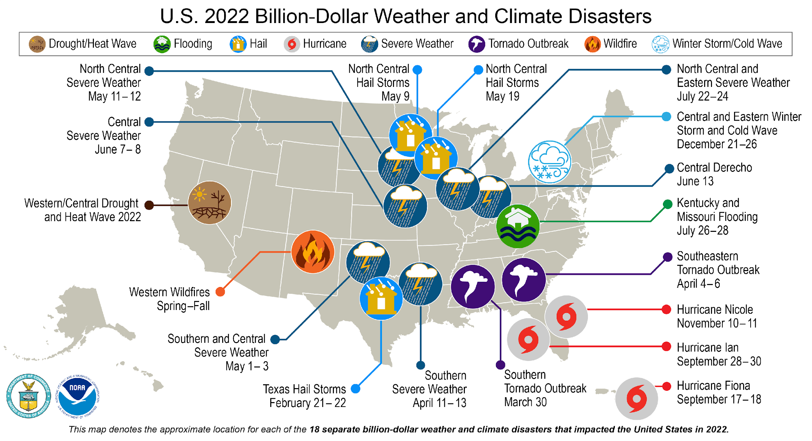
Location of Disasters in USA

Slide 7
Data Description and Pre-processing
Kenneth R. French daily stock index returns
NYSE, AMEX and NASDAQ
Division of portfolio under sectors
Non-Gaussian data distribution
Presence of Heteroskedasticity and Autocorrelation
Standard descriptive statistics:
Lowest returns: “Communication” industry
Highest volatility: “Coal” Industry
6 Months before event
Disaster
6 Months after event
Data bifurcation for modelling

Slide 8
Disaster Impact: Model Layout
Fit AR-GARCH Model
Model Residuals using Peak over Thresholds
Fit Copulas and Test Hypothesis for Contagion
Create Network for contagion channel
Ideal for Stock Market Returns
Applying Extreme Value Theory
Considering 435 pairs of Industry Sectors
Utilizing Graph Theory for computation

Slide 9
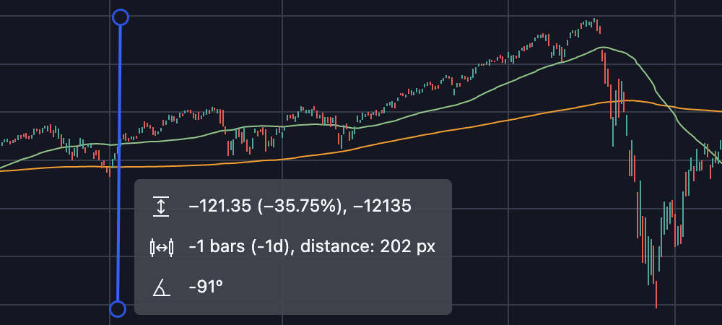
Extreme Value Theory (EVT)
Covid March 2020
Statistical analysis of extreme events
Cannot assume normality
Point of interest for risk management

Slide 10
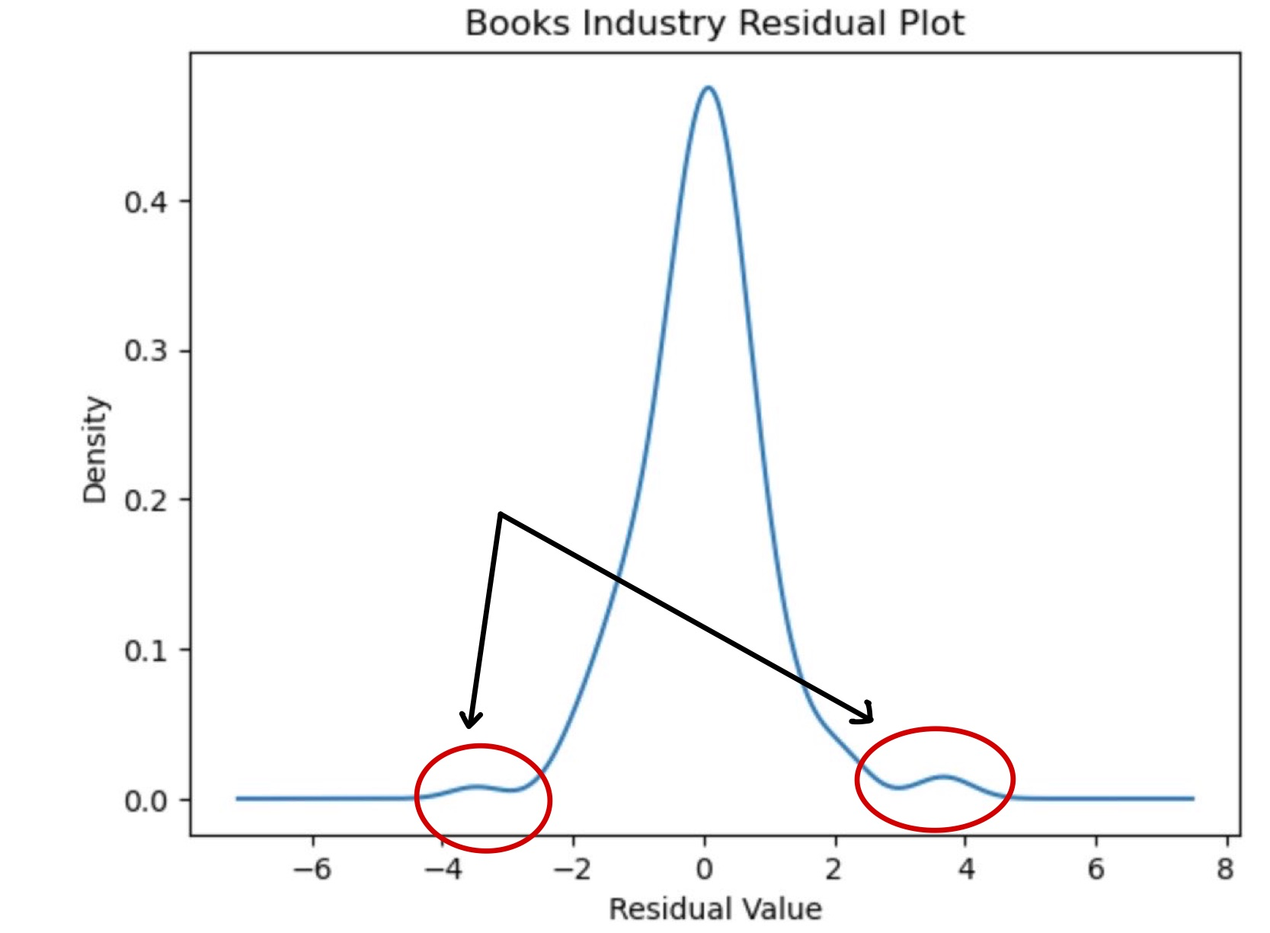
Peak over Threshold (PoT)
EVT
Model Returns beyond a threshold
Distributions used to model extremes:
Generalized Pareto Distribution (GPD)
Weibull
Modelling Maximas
PoT
GPD
Notes:
Peak over Threshold (POT) is a statistical method used in Extreme Value Theory (EVT) to model the events that exceed a certain threshold value.
It is a subset of the Extreme Value Theory and is widely used in the industry to model extreme events such as the ones discussed in our project.
POT focuses on events that exceed a pre-defined threshold, and treats them as a separate class of extreme events.
It is used to model this tail of the distribution beyond this threshold.
For our project we have taken the top 10 percent and bottom 10 percent of the data to be modelled in a GPD and the interior as a Normal Distribution
You can see the peaks beyond the normal looking distribution as a visual representation of the extreme events.
There are different ways to model this tail distribution
One common approach is to model the exceedances over the threshold with a GPD(Generalized Pareto Distribution), which is a flexible distribution that can capture different tail behaviors, such as heavy-tailed or light-tailed distributions.
The GPD is characterized by two parameters: the shape parameter (denoted by ξ) and the scale parameter (denoted by σ). The shape parameter determines the tail behavior of the distribution, with positive values indicating heavy-tailed behavior and negative values indicating light-tailed behavior. The scale parameter determines the scale or spread of the distribution.
Other distributions: In addition to GPD, other distributions such as the Generalized Extreme Value (GEV) distribution and the Weibull distribution can also be used to model extreme data in POT analysis, depending on the characteristics of the data and the specific application.

Slide 11
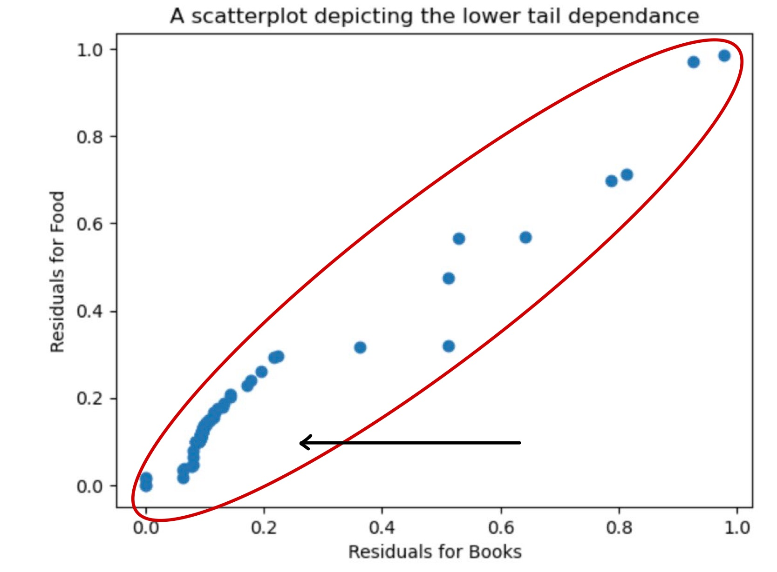
Copulas between Industries
Dependance structure
Advantages
Non - linear, asymmetric relationships
Data simulation
Types of Copulas
Archimedean
Clayton: Lower Tail
Gumbel: Upper Tail
Gaussian
Dependance structure
Notes:
Copulas are a statistical tool used to model the dependence structure between multiple variables, by capturing the joint distribution separately from the marginal distributions.
That is, they helps us understand how variables are related to each other, without making assumptions about how each variable behaves on its own.
Copulas are advantageous because they can capture a wide range of dependence patterns, including linear, non-linear, and asymmetric relationships, and they can also model extreme events. This makes them particularly useful for analyzing variables with heavy-tailed distributions or variables that exhibit tail dependence, where the behavior of the variables in the tails of their distributions is of interest.
They also allow for the generation of synthetic data with specified relationships, which is useful in simulations, risk assessments, and scenario analyses.
In our data we mainly see a lower tail dependency evident by the concentration of data points in the lower left region.
The Clayton copula is commonly used to model lower tail dependence. It is an Archimedean copula characterized by its concave shape and is suitable for modeling the dependence between variables that exhibit a higher likelihood of extreme events occurring together in the lower tail of their distributions. The Clayton copula is often used in applications where the variables tend to move in the same direction, especially in the tails of their distributions, and exhibit a stronger dependence in the lower tail.
Other copula structures, such as the Gumbel copula and the Frank copula, can also capture lower tail dependence to some extent. However, the Clayton copula is specifically designed to model such dependence patterns and is often preferred when the focus is on modeling lower tail dependence in multivariate data

Slide 12
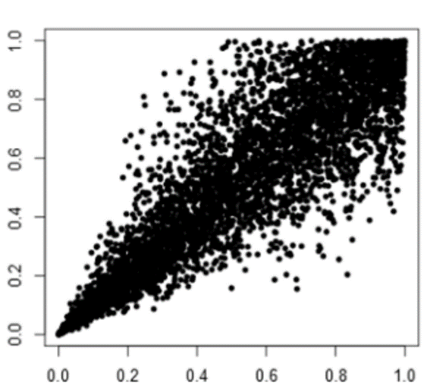

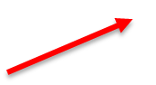
Tail Dependence
Measures probability of extreme events happening jointly
Calculating tail dependence between all sector pairs
Lower Tail Dependence :
Captures the extreme negative events
Clayton Copula: Lower tailed copula
Used in Network creation
Great Flood of 2016
Food
Wholesale
Notes:
Talking about the theory of tail dependence, it measures the probability of extreme events jointly. In our case, it measures the probability of the extreme events happening jointly for each pair of the industry. It is more useful in our case because it only depends on the industries as a pair. In general, we look at two tail dependencies: upper tail dependency and lower dependency. Our focus is on the lower tail dependence which shown in the figure. It is important in our because it captures how south can things go when an extreme event occur. For this purpose, clayton copula is widely used because it is accurate when it comes to lower tail dependence. We will use the tail dependence in network creation. Next moving on to Testing for contagion.

Slide 13
Testing for Contagion
𝐻₀: 𝜆_{𝑐𝑟𝑖𝑠𝑖𝑠} ≤ 𝜆_{𝑝𝑟𝑒−𝑐𝑟𝑖𝑠𝑖𝑠}
𝐻₁: 𝜆_{𝑐𝑟𝑖𝑠𝑖𝑠} > 𝜆_{𝑝𝑟𝑒−𝑐𝑟𝑖𝑠𝑖𝑠}
Network links imply a disaster driven contagion
Lower Tail Dependencies (𝜆) is used as measurement of contagion
Network link is created if 𝐻₀ is rejected
 | Steel | FabPr | ElcEq | Autos | Carry | Mines
Hlth | 0 | 1 | 1 | 1 | 0 | 1
Chem | 0 | 0 | 0 | 1 | 0 | 1
Txtls | 0 | 1 | 1 | 1 | 1 | 0
Cnstr | 0 | 0 | 0 | 0 | 0 | 0
ElcEq | 1 | 0 | 0 | 0 | 0 | 1
Notes:
Here, we have used tail dependencies enlisted as lambda for hypothesis testing with null hypothesis stated that the tail dependence of post crisis is less than that of post crisis with alternate hypothesis being the other way around So, if the null hypothesis is rejected, meaning that there is a disaster driven contagion, we would then proceed to create a link in the network between the concerned industry pair. This can be seen from the table for the network creation between the concerned pair of industries. Next moving on to the network graphs.

Slide 14
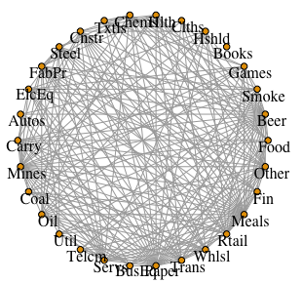
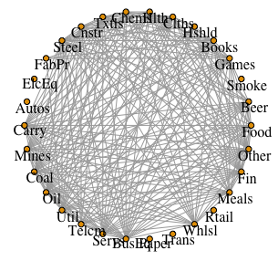
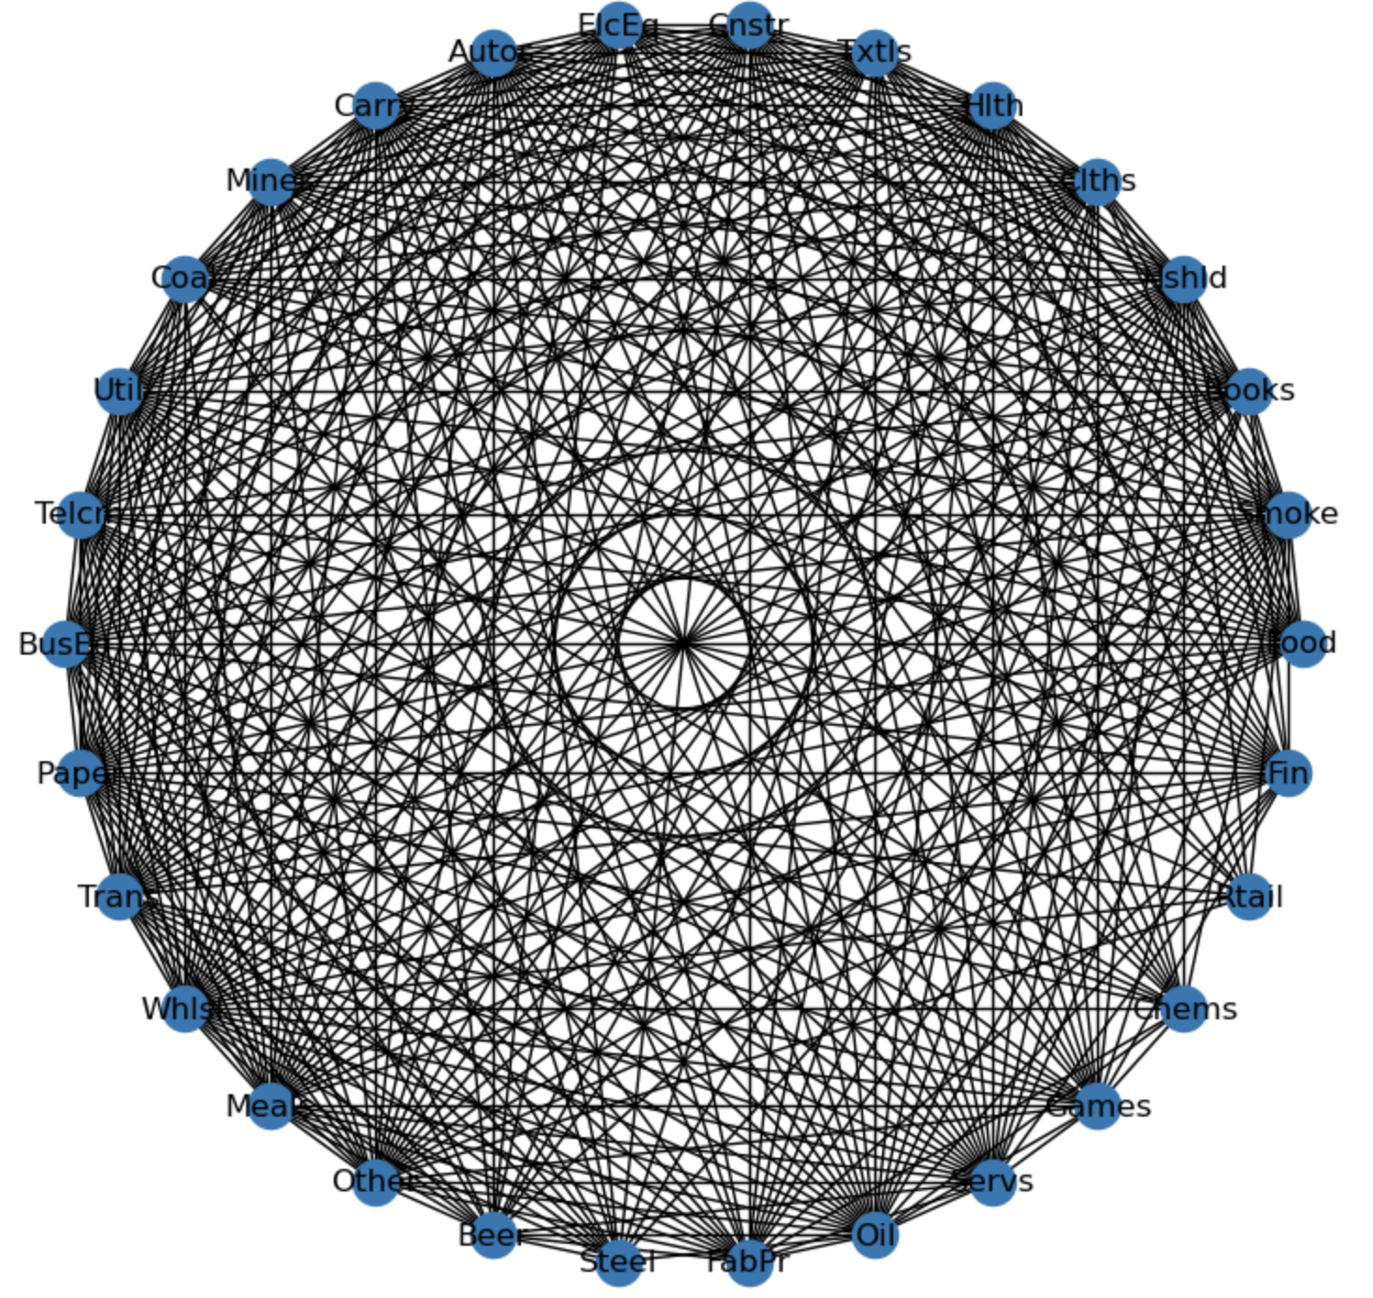
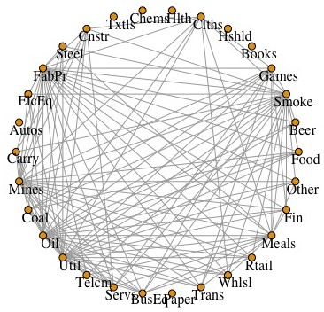
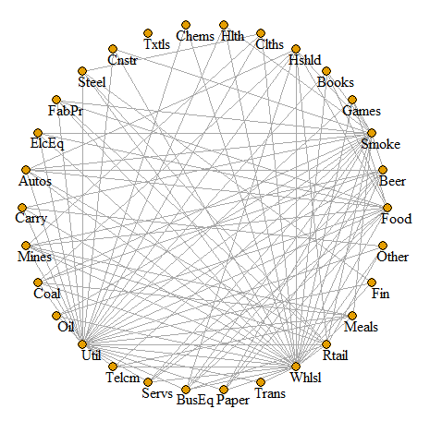
Networks
Oil Crisis of 1973
California Wildfires
Covid-19
Hurricane Katrina
Great flood of 2016
Notes:
Now, looking at the networks, which is the visual representation of the networks with covid 19 being most densely populated and great floods of 2016 being sparsely populated. Now I will hand over to Nakul who will dive deep in to the analysis of the networks

Slide 15
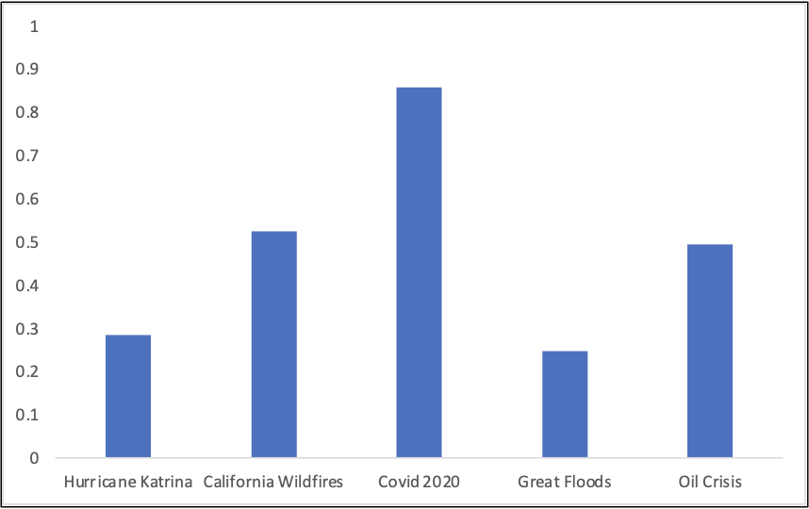
Network Density
Covid has the highest network density.
The lowest network density is for Great Floods.
Notes:
The networks in the previous slide are not very helpful to analyse the results. To get a better understanding of the networks, we can look at a metric called Network Density, which is an estimate of the number of networks that exist in a graph. A network density of 1, implies that every node is connected to every other node in the graph and 0 implies that the network does not have nodes at all. In this histogram, it is evident that Covid has the highest network density, followed by California WildFires and Great Floods has the lowest density. As mentioned in the beginning of the slide, Covid had the highest losses and Great Floods had the lowest losses. The result we observe here agrees with that fact.

Slide 16
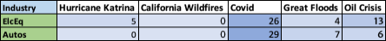
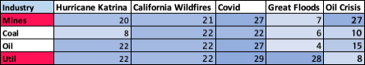
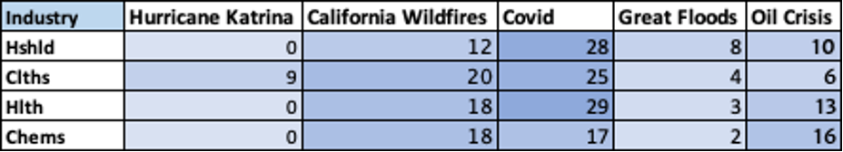
Electricity and Autos have the lowest degrees across the five disasters analysed.
Utilities and Mines have degrees over 20 in at least 4 of the 5 disasters.
Notes:
In the table on the slide, the left most column is that of the sectors and the numbers under each disaster refers to the number of links between that particular sector to the other sectors during that particular disaster. So for sector Mines has a value of 20, under Hurricane Katrina, which tells that 20 links(lower tail dependencies) were there between Mines and the other sectors when Hurricane Katrina happened. On analysing the entire results, we can see that Electricity and Autos have the lowest degrees across the five disasters we have considered. Mines and Utilities has the highest degrees across the 30 sectors we considered.

Slide 17
Conclusions
Covid-19 and California Wildfires 2018 were the easiest to drive financial contagion.
Great Floods had the least impact on industries.
Sectors with 0 links, serve as potential investment sectors to hedge tail risk.
Notes:
As we saw in the previous slides, Covid-19 and WildFires have the highest network densities and thus, they were easiest to drive financial contagion. Great Floods having the least network density and losses, had the least impact on industries. One of the main takeaways from this analysis is that, sectors with less degrees during a disaster,serve as potential investment sectors to hedge the lower tail dependence risk.

Slide 18
Future Work
Including derivatives and analyzing cross-country contagion models.
Determining the Channel of Contagion between industries.
Dynamic Copula, Machine Learning methods and modelling using Stochastic Differential Equations can be explored.
Notes:
For future work, we can include more derivatives and include different countries to create cross country contagion models. We can also look whether the channel of contagion is due to the wealth or the income. We can extend the analysis by looking at Machine Learning methods, Dynamic Copula and even SDES. Thank you all for listening and we are open to any questions that you may have.

